Slide 1
Outline
Why ranked retrieval?
Term frequency
tf-idf weighting
The vector space model
Notes:
In this session we discuss the tf-idf weighting scheme.

Slide 2
Frequency in document vs. frequency in collection
In addition, to term frequency (the frequency of the term in the document) . . .
. . .we also want to use the frequency of the term in the collection for weighting and ranking.
‹#›
Notes:
We will look at the frequency of terms in a document vs the frequency of terms in the collection

Slide 3
Desired weight for rare terms
Rare terms are more informative than frequent terms.
Consider a term in the query that is rare in the collection (e.g., ARACHNOCENTRIC).
A document containing this term is very likely to be relevant.
→ We want high weights for rare terms like ARACHNOCENTRIC.
‹#›
Notes:
The aim is to assign a higher weight to rare terms as a strategy for emphasizing their importance.
Rare terms are more informative than frequent terms.
For example, consider a term in the query that is rare in the collection (e.g., ARACHNOCENTRIC).
A document containing this term is very likely to be relevant.
And therefore we want high weights for rare terms like ARACHNOCENTRIC.

Slide 4
Desired weight for frequent terms
Frequent terms are less informative than rare terms.
Consider a term in the query that is frequent in the collection (e.g., GOOD, INCREASE, LINE).
A document containing this term is more likely to be relevant than a document that doesn’t . . .
. . . but words like GOOD, INCREASE and LINE are not sure indicators of relevance.
→ For frequent terms like GOOD, INCREASE and LINE, we want positive weights . . .
. . . but we want the frequent terms to have lower weights than the rare terms.
‹#›
Notes:
With regards to frequent terms,
Consider terms in the query that are frequent in the collection (words such as GOOD, INCREASE, LINE).
A document containing these frequently occurring terms is more likely to be relevant than a document that doesn’t . . .
. . . but words like GOOD, INCREASE and LINE are not reliable indicators of relevance.
Therefore for frequent terms like GOOD, INCREASE and LINE, we want positive weights . . .
. . . but we want the frequent terms to have lower weights than the rare terms.

Slide 5
Document frequency
We want high weights for rare terms like ARACHNOCENTRIC.
We want low (positive) weights for frequent words like GOOD, INCREASE and LINE.
We will use document frequency to factor this into computing the matching score.
The document frequency is the number of documents in the collection that the term occurs in.
‹#›
Notes:
Now let’s look at document frequency.
We want high weights for terms like ARACHNOCENTRIC, because these are rare.
And we want low (positive) weights for frequent words like GOOD, INCREASE and LINE.
We will use document frequency to factor this into computing the matching score.
The document frequency is the number of documents in the collection that the term occurs in.

Slide 6

idf weight
df_{t} is the document frequency, the number of documents that t occurs in.
df_{t} is an inverse measure of the informativeness of term t.
We define the idf weight of term t as follows:
(N is the number of documents in the collection.)
idf_{t} is a measure of the informativeness of the term.
[log N/df_{t} ] instead of [N/df_{t} ] to “dampen” the effect of idf
Note that we use the log transformation for both term frequency and document frequency.
‹#›

Slide 7

Examples for idf
Compute idf_{t} using the formula:
term | df_{t} | idf_{t}
calpurnia animal sunday fly under the | 1 100 1000 10,000 100,000 1,000,000 | 6 4 3 2 1 0
the more freq. the term appears across the collection the less is its informativeness
(N is the number of documents in the collection.)
df_{t} is the document frequency, the number of documents that t occurs in.
‹#›
Notes:
1000,000/1=1
Log10(1)=6
1000,000/100=10,000
Log10(10,000)=4
1000,000/1000=1000
Log10(100,000)=3
As you can see the log 10 of 1 million is 0. So, if a term appears in all 1m documents in the collection it is 0

Slide 8
Effect of idf on ranking
idf affects the ranking of documents for queries with at least two terms.
For example, in the query “arachnocentric line”, idf weighting increases the relative weight of ARACHNOCENTRIC and decreases the relative weight of LINE.
idf has little effect on ranking for one-term queries.
‹#›

Slide 9
Global frequency vs. Document frequency
term | collection frequency (cf) | document frequency (df)
INSURANCE TRY | 10440 10422 | 3997 8760
Collection frequency of t: number of times a term (or token) t appears in the entire collection
Document frequency of t: number of documents t occurs in. How many documents contain the term insurance? How many times does insurance occur across the collection?
Why these numbers?
Which word is a better search term (and should get a higher weight)?
This example suggests that df (and idf) is better for weighting than cf (and “icf”).
‹#›
Notes:
The term insurance appears 104,440 times in the 3997 documents in the collection.
collection frequency = cf

Slide 10

tf-idf weighting
The tf-idf weight of a term is the product of its tf weight and its idf weight.
tf-weight
idf-weight
Best known weighting scheme in information retrieval
Note: the “-” in tf-idf is a hyphen, not a minus sign!
Alternative names: tf.idf, tf x idf
‹#›

Slide 11

Summary: tf-idf
Assign a tf-idf weight for each term t in each document d:
Note that we are using the log of the tf for the local weight part of the formula.
The tf-idf weight . . .
. . . increases with the number of occurrences within a document. (term frequency)
. . . increases with the rarity (infrequency) of the term in the collection. (inverse document frequency)
‹#›

Slide 12
Recap: Term, collection and document frequency
Quantity | Symbol | Definition
term frequency document frequency collection frequency | tf_{t,d} df_{t} cf_{t} | number of occurrences of t in d number of documents in the collection that t occurs in total number of occurrences of t in the collection
‹#›

Slide 13
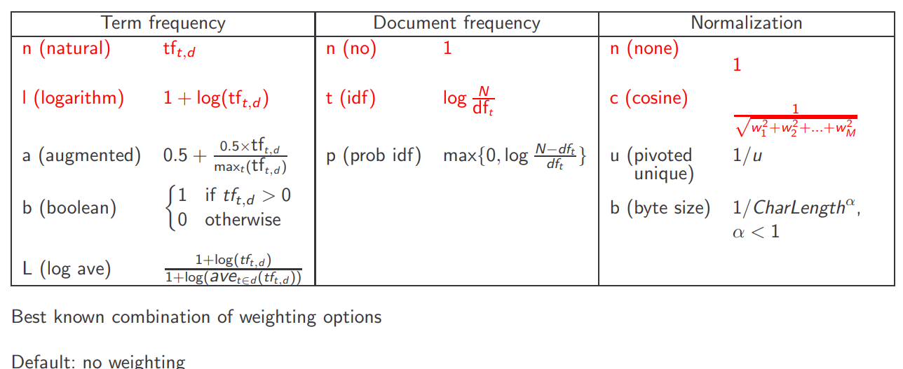
Components of tf-idf weighting
‹#›
Notes:
There are other weighting scheme we can use besides tf-idf. For example we can replace the local tf frequency by

Slide 14
Summary: Ranked retrieval in the vector space model
Represent the query as a weighted tf-idf vector
Represent each document as a weighted tf-idf vector
Compute the cosine similarity between the query vector and each document vector
Rank documents with respect to the query
Return the top K (e.g., K = 10) to the user
‹#›

Slide 15
Outline
Why ranked retrieval?
Term frequency
tf-idf weighting
The vector space model

